Slide 1

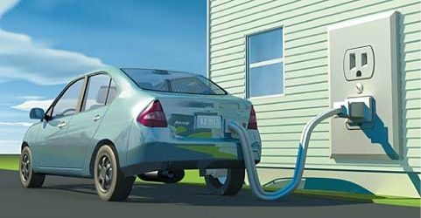
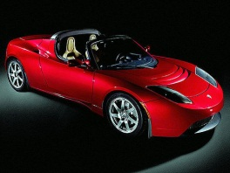

Electric Vehicles:
Matching Low-Carbon Technology to People and Policy
Jonn Axsen
Resource and Environmental Management
Simon Fraser University
August 20, 2014

Slide 2
My research program at SFU:
Social and technical aspect of sustainability
Topics:
“Sustainable” technology (PEVs, smart grid, etc.)
Citizen acceptance of energy
Policy design
“Green” values and lifestyle
Social influence
Methods:
Surveys (consumers, citizens)
Interviews
Energy-economy modeling
Qualitative methods (media analysis, policy analysis)

Slide 3
Today’s Menu
Why plug-in vehicles (PEVs)?
Watch out for hype!
Environmental impacts?
Consumer interest:
    Awareness is low
    Want PHEVs
    Variety of motives
Recharge infrastructure?
Policy for PEVs…?

Slide 4
1.Why plug-in electric vehicles (PEVs)?

Slide 5
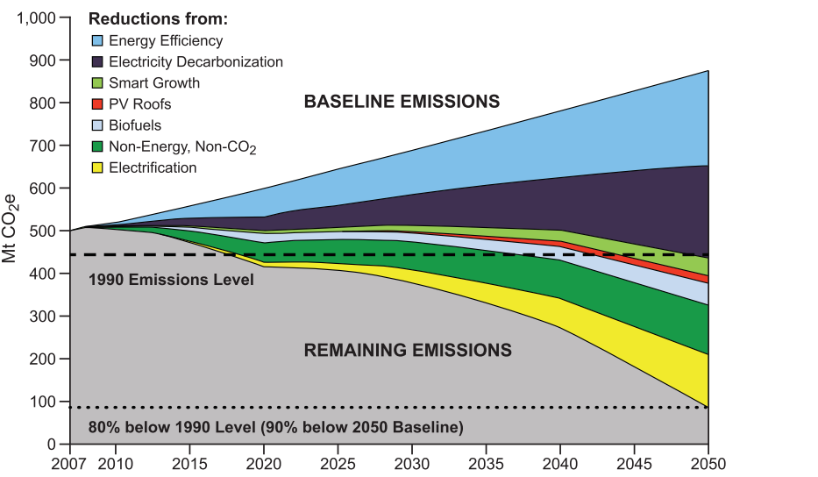
Electric mobility may play an important role in deep GHG reductions
De-
carbonize
electricity
Electrify
vehicles
Source: Williams et al. (2012), Science

Slide 6
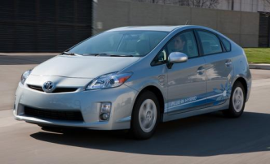
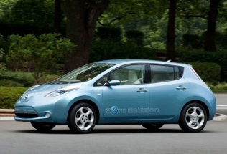
Huge variety among plug-in vehicles
20 km
~800 km gasoline
Plug-in
Hybrid
(PHEV)
Toyota Prius PHV
~56 km
~500 km gasoline
Chevy Volt
~117 km electric range
Pure
Electric
(EV)
Nissan Leaf
~300km electric range
Tesla Roadster
53 kWh
24 kWh
Comparing Battery Sizes:
16 kWh
4 kWh

Slide 7

Electric mobility as a socio-technical case study
Behaviour
Technology
A societal
transition?
Batteries?
GHGs?
Learning and social influence?
Grid
impacts?
Willingness to adapt?
Recharge
infrastructure?
Awareness and preferences?
Consumer
demand?
Cost?

Slide 8
2. Watch out for alternative fuel
“hype”

Slide 9
Media attention by AFV technology
Source: Melton, Axsen & Sperling (2014)

Slide 10
Media attention and key trigger events for plug-in electric vehicles
Source: Melton, Axsen & Sperling (2014)

Slide 11
Evaluations and innovation activities for plug-in electric vehicles
Source: Melton, Axsen & Sperling (2014). Notes: Prototype index 1991=100, derived from Sierzchula et al. (2012); funding index 1992=100, derived from DoE (2014)

Slide 12
3. PEVs can have low environmental impact

Slide 13
EV batteries account for 7-15% of lifecycle environmental impacts
GHG
Emissions
Source: Notter et al. (2010), Environmental Science and Technology

Slide 14
Carbon emissions greatly depend on the source of electricity
Regular vehicles
EV
PHEV-40
46%
PHEV-20
Driving
Carbon
Intensity
(gCO₂/
mile)
Hybrid
Natural Gas
Coal
California
Average
U.S.
Average
Source: Axsen et al. (2011), Energy Policy

Slide 15
We should look at PEV as a pathway,
electrify as we decarbonize
Regular vehicles
EV
PHEV-40
Driving
Carbon
Intensity
(gCO₂/
mile)
PHEV-20
Hybrid
Green electricity
U.S.
Future?
U.S.
Today
Source: Axsen et al. (2011), Energy Policy

Slide 16
The case for EVs is more clear in Canada
Regular vehicles
EV
PHEV-40
Driving
Carbon
Intensity
(gCO₂/
mile)
PHEV-20
Hybrid
BC
Today
Canada
Today
Alberta
Today
Source: Axsen et al. (2011), Energy Policy

Slide 17
4a. Consumers:
Low awareness

Slide 18
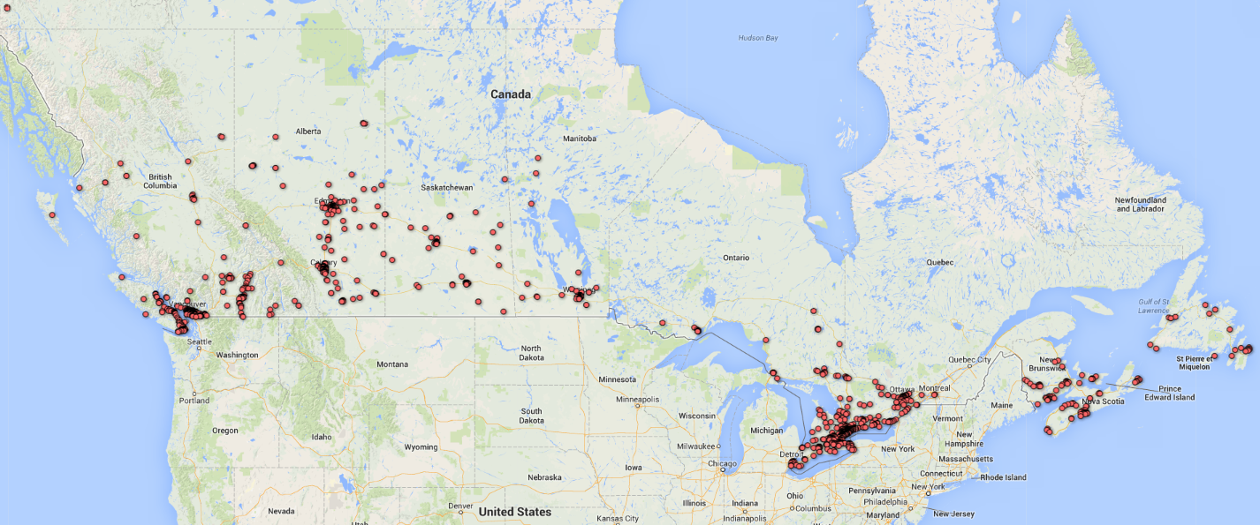
Canadian PEV Survey (CPEVS 2013) n = 1754
Sample is generally representative of new car buyers:
  Older, higher income, more highly educated,
  more likely to own their own home

Slide 19
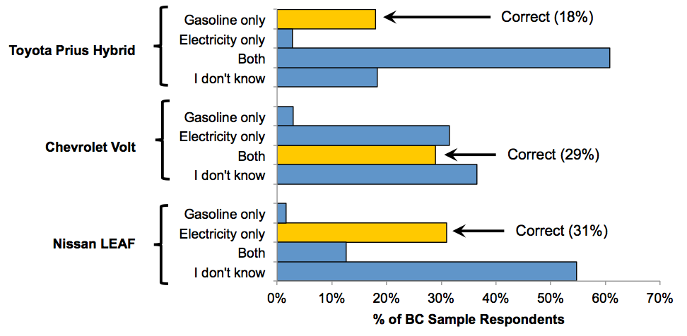
Confusion of innovations:
“How is each of the following vehicle fueled?
Source: Axsen, Bailey and Kamiya (2013), CPEVS 2013 Preliminary Report

Slide 20
4b. Consumers: want plug-in hybrid vehicles

Slide 21
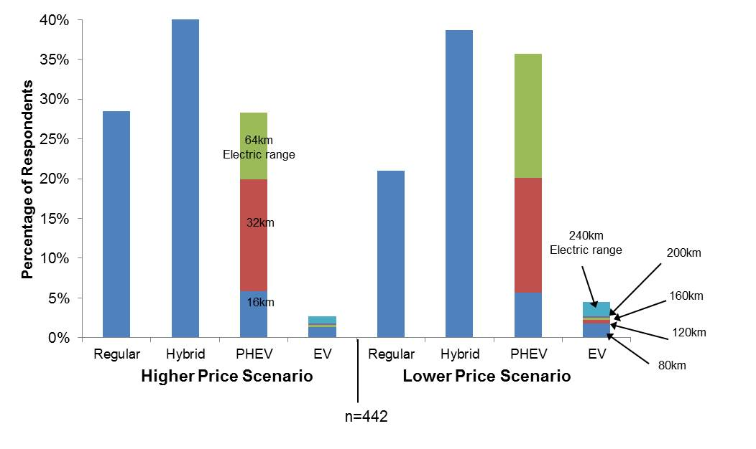
People are more attracted to PHEVs,
not so much EVs
Source: Axsen, Bailey and Kamiya (2013), CPEVS 2013 Preliminary Report

Slide 22
4c. Consumers: variety of motives

Slide 23
“PEV-enthusiasts” have very high willingness-to-pay – an extreme segment
PEV-enthusiasts (8%)
Willingness-
to-pay
(relative to
conventional
Vehicle)
PHEV-
oriented
(25%)
HEV-
oriented
(16%)
HEV-
leaning
(28%)
CV-
oriented
(23%)

Slide 24
“PEV-oriented” segment is larger, with emphasis on PHEV designs
PHEV-oriented (25%)
HEV-oriented
(16%)
Willingness-
to-pay
(relative to
conventional
Vehicle)
HEV-leaning
(28%)
CV-oriented
(23%)

Slide 25
PEV buyers can vary substantially by tech- and enviro- lifestyle
Techie
Tech-
enviro
Tech-
oriented
Lifestyle
(Score,
1-25)
Open
HEV
buyer
Strong-
enviro
CV
buyer
Unengaged
Concerned
Enviro-oriented Lifestyle (Score, 1-25)

Slide 26
PHEVs are most popular in all lifestyle segments. But motives differ…
“Strong-
Enviro”
“Tech-
Enviro”
“Concerned”
“Techie”
“Un-
engaged”
Willingness-
to-pay
(relative to
conventional
Vehicle)
“Open”

Slide 27
5. Recharge infrastructure

Slide 28
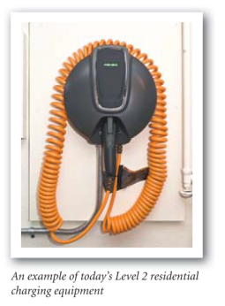
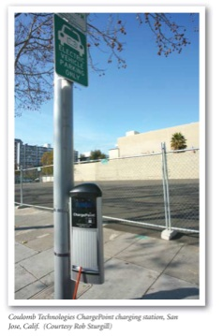
Not enough chargers?
Level 1: Regular outlet (1-2 kW)
Level 2: Your dryer outlet (3-6 kW)
Level 3: Fast charging (20-200 kW)
Work
Charging
Home Charging
Public
Source: Duvall (2009), Plug-in 2009

Slide 29
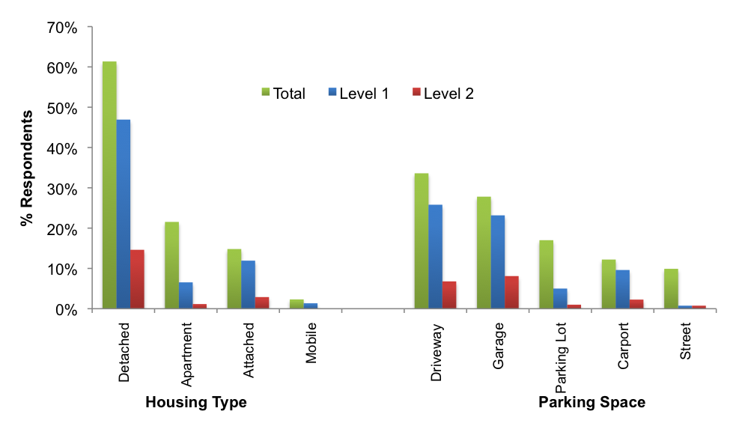
66% of BC car buyers have Level 1 access
20% have Level 2 access
Source: Axsen, Bailey and Kamiya (2013), CPEVS 2013 Preliminary Report

Slide 30
Early market consumers can recharge with Level 1, mostly at home, at night
% of
Respondents
Parked
Within
25 ft. of
Electrical
Outlet
Work
Other
Home Potential
Time of Day (Hours)
Source: Axsen and Kurani (2009), Transportation Research Record

Slide 31

Grid Impacts: without constraints, recharge demand will peak on weekday evening
MW
per
million
PHEVs
Unconstrained
(48% less gas)
Time of Day (Hours)
Source: Axsen and Kurani (2010), Transportation Research Part D

Slide 32
Additional workplace/public access will increase daytime load
Mandate
workplace
charging
(50% less gas)
Unconstrained
(48% less gas)
MW
per
million
PHEVs
Time of Day (Hours)
Source: Axsen and Kurani (2010), Transportation Research Part D

Slide 33
Forcing off-peak will reduce charging opportunities, but potentially benefit grid
Mandate
workplace
charging
(50% less gas)
Unconstrained
(48% less gas)
MW
per
million
PHEVs
Force
off-peak
(45% less gas)
Time of Day (Hours)
Source: Axsen and Kurani (2010), Transportation Research Part D

Slide 34
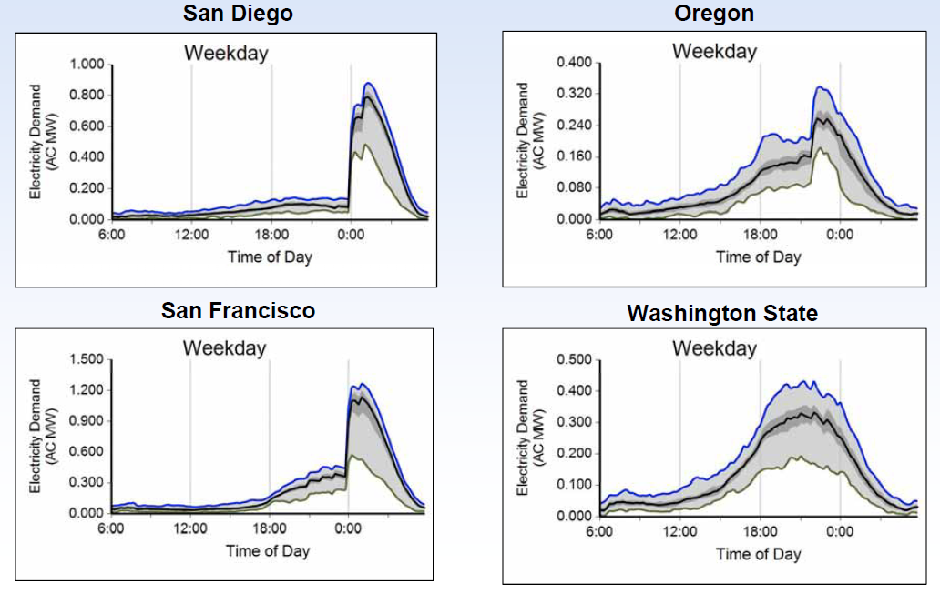
Test data shows that “time of use” pricing can easily change timing of PEV charging
Source: Idaho National Labs (2012)

Slide 35
6. Should policy “force”
PEVs…?

Slide 36
The CIMS energy-economy model:
Simulating dynamics in technology and behaviour
Increasing returns to adoption of new technology:
  “Learning-by-doing” (declining capital costs)
  “Neighbour effect” (declining intangible costs)
↑users leads to ↑consumer acceptance for a given technology
NEIGHBOUR EFFECT
LEARNING BY DOING
?
?
Intangible
Cost
Capital
Cost
Market share
Cumulative production
Notes:
In the model these two parameters are both endogenous, which means that they are determined by the interaction other model parameters and not by a baseline forecast. This creates increasing returns to adoption.
Most of the uncertainty surrounding the outcome of technology-specific policies comes from uncertainties over the strength of IRA effects.
The neighbour effect is included through upfront non-financial or intangible costs that decline based on increased market share, by an s-shaped curve.
Also when a technology is more adopted, its production increases which for new technologies decreases the purchase price through learning and economies of scale (until it eventually reaches its long term, mature cost).
This is a stylized example. The dynamics of these effects may be different for each specific vehicle technology.
The concern with tech-neutral policies is that you might need to reach a key threshold to activate these effects if at all. This is the theoretical justification for tech-specific policies
Again we are uncertain of the exact dynamics of these effects

Slide 37
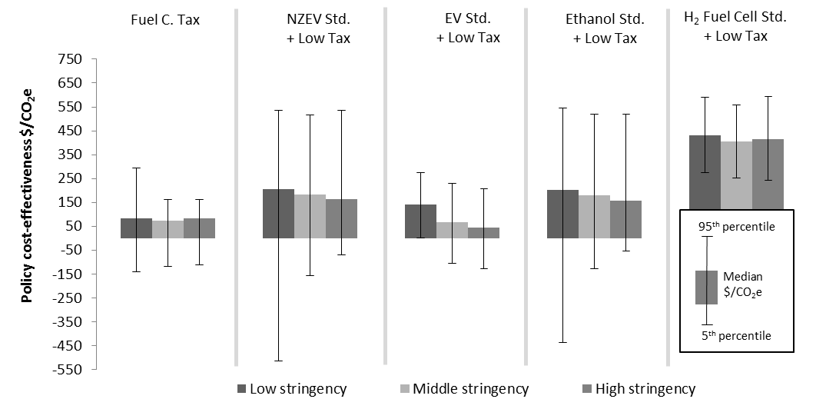
A technology-specific policy may be cost-effective. Especially if you choose the right winner (PEVs in this case).
Carbon
Tax
General
Standard
(PEV, E85, H2)
PEV Only
E85 Only
H₂ Only
Source: Fox, Axsen, Jaccard (Under review). Resource and Energy Economics

Slide 38
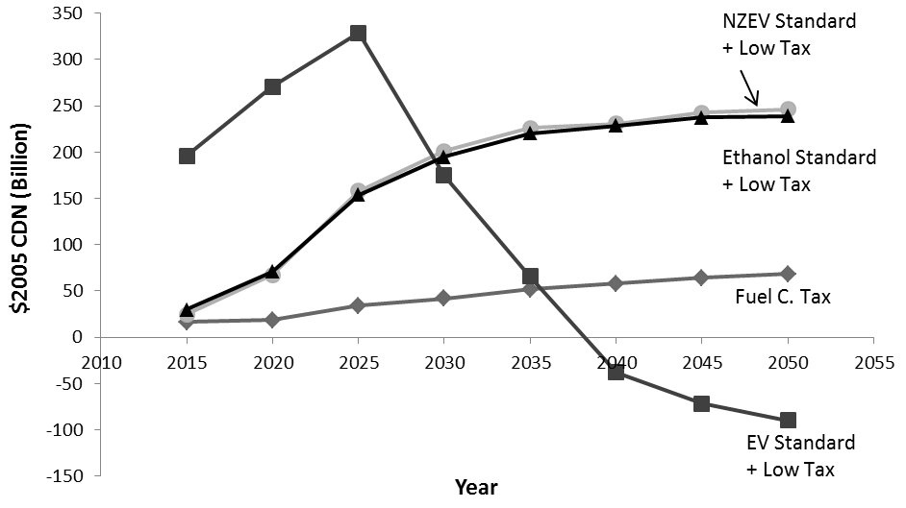
A technology-specific policy can more quickly push a low-carbon through low-cost thresholds (see PEVs)
General
standard
E85 Only
Carbon Tax
PEV Only
Source: Fox, Axsen, Jaccard (Under review). Resource and Energy Economics

Slide 39
Conclusions

Slide 40
Conclusions:
Inducing a societal shift to PEVs
Zero-emissions vehicle policy:
strong push for supply
Include PHEVs within PEV policy
Build basic awareness: mostly of PHEVs
Marketing: consider full range of consumer motives (environment, techie, fuel savings, symbolism and more)
Recharge infrastructure: focus on home and workplace

Slide 41
Extras

Slide 42
Directions for climate policy?
Financial incentives
  Can be helpful, but aren’t enough for full transition
Regulation
  Zero-emissions standards: maybe better to force “electric” but be sure to allow PHEVs and PEVs
  Need long-term signals for industry/consumers
R&D funding
  Need some consistency – avoid short-sighted “hype cycles”
Recharge infrastructure
  Priority on home, then workplace, then public
Information campaigns…?
  Greater awareness is needed, but direct efforts by government are not likely to be effective

Slide 43
Concluding with a dynamic perspective on electric mobility
Today:
- Expensive
- Limited range
- Grid impacts vary
- Limited charging
Future Change:
With supportive policy
- Costs decrease
- Improved performance
- Clean electricity
- More charging
Our
technical
knowledge:
Future Change:
With supportive policy
- Increased exposure
- Increased demand
- Further electrification
- New social norms?
Today:
- Little awareness
- Interest in PHEVs
- Home charge works
- Variety of motives
Our
behavioural
knowledge:

Slide 44
Future directions to study electric mobility
Behaviour
Technology
Batteries
are ready to start
Link with low-carbon electricity
Stimulate societal transitions
Induce social learning
Manage
electrical load
Motivate willingness to adapt
Utilize existing
plug-in
opportunities
Improve
awareness of
options
Start with mostly
plug-in hybrids, move on to EVs
Reduce price through industry learning

Slide 45
5. Policy for PEVs…

Slide 46
Directions for PEV policy?
Technology neutral or specific?
 | Focus of policy
Policy type | PEV purchase | PEV use | Recharge infrastructure
(Dis)incentives | Subsidies Tax rebates Feebate | Time-of-use rates Free public charging | Subsidies for install … at home. …at work. …public. Free “smart chargers”
Regulation | ZEV standards CAFE standards | Low-carbon fuel standard | Building codes (with chargers or charger-ready)

Slide 47
4) What about batteries?

Slide 48
Are batteries ready for electric-vehicles?
More
Power
Battery
Power
(W/kg)
MIT Goals
U.S. DOE Goals
NiMH
Li-Ion
Battery Storage (Wh/kg)
More Miles
Source: Axsen and Kurani (2010), Transport Policy

Slide 49
Batteries are ready for what people want: lower range PHEVs
More
Power
Battery
Power
(W/kg)
MIT Goals
U.S. DOE Goals
NiMH
Li-Ion
Battery Storage (Wh/kg)
More Miles
Source: Axsen and Kurani (2010), Transport Policy

Slide 50
Connecting to “green” electricity

Slide 51
Pairing renewables & PEVs
Many sources of renewables are intermittent so the timing of electricity supply may not match the timing of electricity demand.
Green Electricity Supply
PEV
Electricity Demand (load)
12am
12pm
11pm

Slide 52
Pairing renewables & PEVs
Many sources of renewables are intermittent so the timing of electricity supply may not match the timing of electricity demand.
Green Electricity Supply
PEV
Electricity Demand (load)
12am
12pm
11pm

Slide 53
Do you want Green Electricity with that?
Complements:
The combination increases PEV demand in all segments
Conventional buyers: PEV demand increase of 23%
Hybrid buyers: PEV demand increase of 20%
PEV buyers: PEV demand increase of 5%
31% combined
EV
PHEV
HEV
CV
None
Green
Program
Green
Lease
Home
Solar
Source: Axsen and Kurani (2013), Environmental Research Letters

Slide 54
Preferences for electricity source when charging PEVs
How do you feel about using the following energy sources to produce electricity for electric vehicles?
n=530
Notes:
The question was:

Slide 55
GHG impacts will depend on the entire system (example: a Nissan Leaf in Alberta)
2014 Nissan Versa
BAU
Zero-emissions electricity
standard
Carbon tax
Alberta, average generation mix, Nissan LEAF-type vehicle (~0.18 kWh/km)
Scenarios:
  PEV Standard: Require 15% (2025) and 60% (2050) of new light-duty passenger vehicles to be PEV.
  Carbon Tax: Escalating economy-wide carbon tax: $0 (2000-2010), $50/t (2011-2020); $100/t (2021-2035); $200/t (2036-2050)
  Zero-Emissions Elec.: No new fossil fuel generation without CCS after 2015.
Source: George Kamiya (Thesis in progress)
Notes:
Versa = 6.7 L/100km avg = ~150g/km

Slide 56
What motivates consumers?

Slide 57
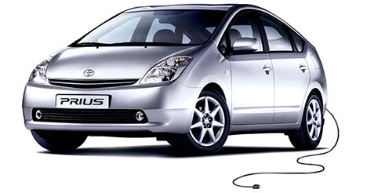
What motivates consumer interest?
Functional
Symbolic
Private
Societal
Source: Axsen and Kurani (2012), Environment and Planning A

Slide 58
What motivates consumer interest?
Functional
Symbolic
  What it does
  for you
  What it
  represents
Source: Axsen and Kurani (2012), Environment and Planning A

Slide 59
What motivates consumer interest?
Functional
Symbolic
  What it does
  for you
  What it
  represents
Private
  What it does
  for society
What it says
to society
Societal
Source: Axsen and Kurani (2012), Environment and Planning A

Slide 60
Main benefits: environment and cost savings
Functional
Symbolic
Private
● Cheap to run (8)
● Quiet (8)
● Home recharge (6)
● Fast acceleration (4)
● Smooth (3)
● Easy parking (3)
● Fun (2)
● Environmental (13)
● Job creation (1)
● Pressure car companies (1)
Societal
n = 21 interviews
Source: Axsen et al. (Under Review), Ecological Economics

Slide 61
Main Drawbacks: range, recharge, cost
Functional
Symbolic
Private
● Limited range (15)
● Expensive (10)
● Recharge access (10)
● Poor acceleration (6)
● Too small (3)
● Recharge time (2)
● Lack of towing (1)
● Too restrictive (4)
● Requires change (3)
● Dangerously quiet (3)
Societal
n = 21 interviews
Source: Axsen et al. (Under Review), Ecological Economics

Slide 62
Main Controversies: range, recharge, cost
Functional
Symbolic
Private
● Battery life? (8)
● Public charging? (6)
● Fuel savings? (2)
● Sporty? (1)
● Lifecycle impact? (17)
  electricity source
  battery disposal
● Too quiet (2)
Societal
n = 21 interviews
Source: Axsen et al. (Under Review), Ecological Economics

Slide 63
How do consumers change?

Slide 64
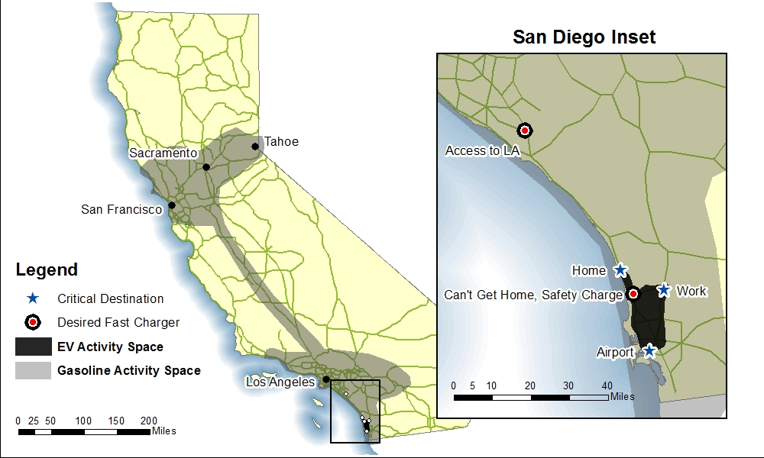
Range anxiety? Many consumers are willing to adapt to limited “activity space”
Source: Axsen et al. (2011), Chap. 2 in STEPS: A Research Summary for Decision Makers

Slide 65
Perceptions of EVs were largely influenced by social interactions, as well through using the EV, and media
# of
high-
influence
experiences
6 mention
“Top Gear”
Source: Axsen et al. (Under Review), Ecological Economics

Slide 66
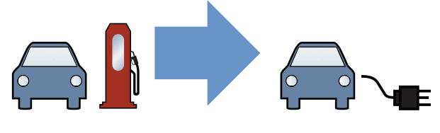
Many controversies surrounding electric mobility
Technology:
  Batteries are bad?
  Electricity is dirty?
  Technology too costly?
  Not enough chargers?
Behavior:
  Lack of Demand?
  Does it “payback”?
  Range anxiety?

Slide 67
Theme: We need a dynamic perspective on technology and behaviour
 | Knowledge about Today (Static) | Knowledge about Future (Dynamic)
Technology | HIGH (Engineering) | MOD-LOW (Learning, R&D)
Behaviour | LOW (Surveys, interviews, markets) | VERY LOW (Experiments?)

Slide 68
What do consumers want?

Slide 69
3 ways for social interactions to influence preferences
Proportion
observed
(UK study):
1) Diffusion:
spread of EV information
“I drove an EV”
Ben
Jane
63%
2) Translation:
negotiate EV controversies
“Where will electricity
come from?”
Clover
Aiden
53%
3) Reflexivity
relating EV to self-identity
7%
Callum
Eva
“Do EVs fit with my
lifestyle and friends?”
Source: Axsen et al. (2013), Ecological Economics

Slide 70
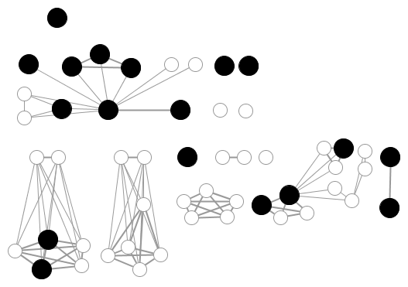
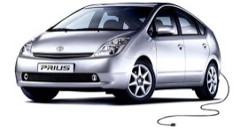
Social Proximity
to Billy
Coworkers
Stranger
Casual
Somewhat
Close
Golf Buddies
Very
Close
Distant
Friends
Former
In-Laws
Girlfriend and Her Daughter
Family
Friends
Billy Woods

Slide 71
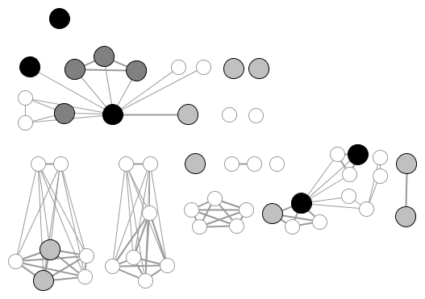
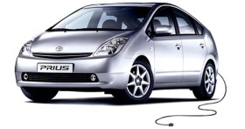
Social Proximity
to Billy
Coworkers
High Influence
Moderate Influence
Low Influence
Stranger
Casual
Jen, Fred, Kara
Somewhat
Close
Golf Buddies
Very
Close
Pat
Distant
Friends
Former
In-Laws
Girlfriend and Her Daughter
Family
Friends
Billy Woods

Slide 72
Social Proximity
to Billy
Coworkers
High Influence
Moderate Influence
Low Influence
Stranger
Harry
Casual
Jen, Fred, Kara
Somewhat
Close
Golf Buddies
Polling others’
motives
(save money
or be green?)
Towards Private:
“all of (my coworkers) said if it
costs less, I’ll buy it…
…(so) I wouldn’t buy it just to
protect the environment”
Very
Close
Pat
Distant
Friends
Former
In-Laws
Girlfriend and Her Daughter
Family
Friends
Billy Woods

Slide 73
In some cases, a plug-in vehicle is a trial of a new lifestyle (e.g. becoming “green”)
Lifestyle Sectors
Green Lifestyle
Green lifestyle
Driving a plug-in vehicle
Family-oriented lifestyle
Recycling
Rock climbing lifestyle
Buying organic produce
Etc…
Bus? Cycle? Vegeterian?
Source: Axsen et al. (2012), Ecological Economics

Slide 74
Vehicle prices vary substantially by vehicle type (shown for sedan)
Source: Axsen and Kurani, Working Paper for Energy Policy

Slide 75





Consumers are constantly trying connect technology with lifestyle and self
“I asked them: why would you buy a hybrid? Mainly to protect the environment or from a consumer standpoint?...All of them said: if it costs less, I’ll buy it.”
“When you’re driving a truck…someone in a Prius doesn’t normally wave at you. They may flip something at you, but it won’t be a wave.”
“I wanted to put my money in my beliefs…and buy a hybrid to promote the production of further hybrid cars.”

Slide 76
Concluding with a dynamic perspective on electric mobility
 | Knowledge about Today (Static) | Knowledge about Future (Dynamic)
Technology | Expensive Limited range Grid impacts vary Limited charging | With supportive policy: Costs will decline Performance will advance Decarbonize electricity More charging
Behaviour | Lack of awareness Interest in simple PHEVs Home charging sufficient Variety of motives | With supportive policy: Increase exposure and demand Start transition to further electrification Develop new social norms

Slide 77
Summary of constraints and opportunities
False constraints:
  Battery costs and performance
  Lack of public charging
  Uncertain environment benefit
  Consumer demand
Real opportunities:
  Build awareness, consumer experience
  Match vehicle design to consumer needs
  De-carbonize electrical grid
  Shift our culture of mobility
  All this can be induced via policy (to an extent)

Slide 78
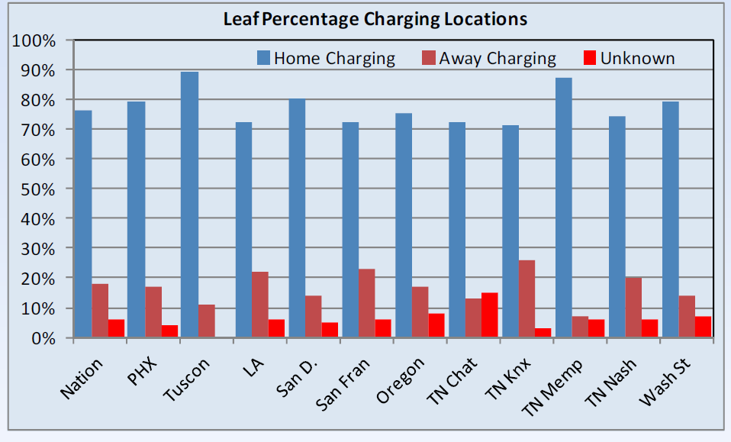
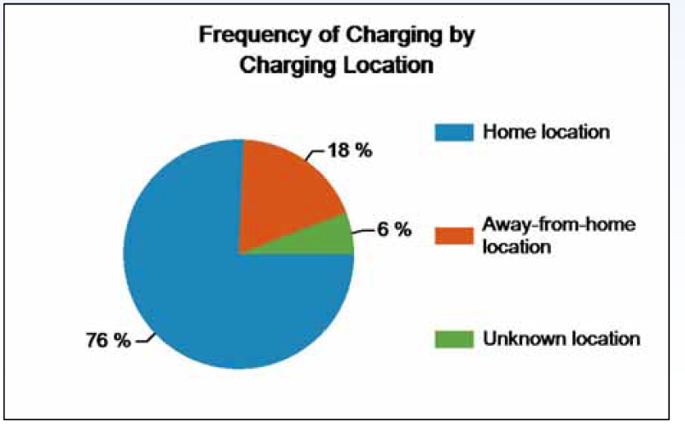
Idaho National Labs says that ~ 76% of charging occurs at home
Source: Idaho National Labs (2012)

Slide 79
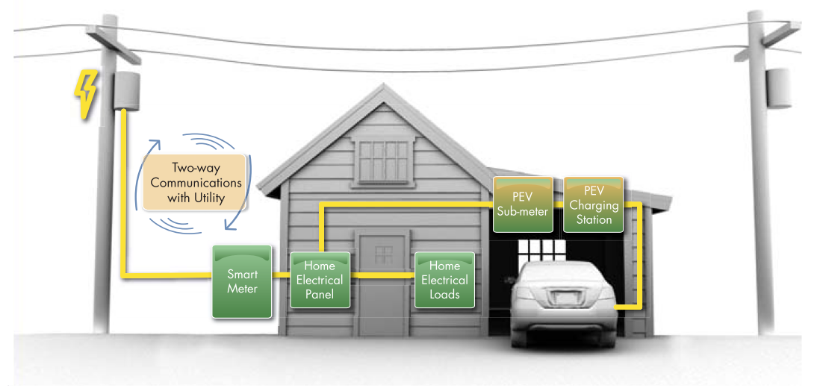

Slide 80
My research program at SFU:
Social and technical aspect of sustainability
 | Topics
Methods | Sustainable technology (PEVs, grid) | Citizen acceptance of energy | Policy design | “Green” values and lifestyle | Social influence
Surveys | US PHEV (CEC) San Diego PEV BMW Green E Canada ecoEII | Pipeline (BC/AB) Canada policy CCS in Alberta “Energy Pulse” |  | Canada lifestyle | UK workplace
Interviews | Canada ecoEII | Pipeline/LNG |  | CA PHEV demo Lifestyle | CA PHEV demo UK workplace
Energy modeling | PEV Grid impacts Canada ecoEII Value of chargers PEV forecast |  | Tech-policy LCFS in BC |  | Neighbour effect
Qualitative Methods (e.g. media analysis) | BC Smart Grid Hype cycle | Pipeline/LNG | ZEV analysis

Slide 81
Understanding technical transitions…
We need a dynamic perspective on technology and behaviour
Our
technical
knowledge:
Future
Change:
Mod-Low
Today:
High
Future
Change:
Very Low
Our
behavioural
knowledge:
Today:
Low

